Slide 1
Relationships between
Toronto apartment’s rental price and safety issue
• Kaiyu WANG

Slide 2
Content
1
Introduction
2
Pre-processing
3
Methodology & Result
4
Discussion & Conclusion

Slide 3
1.Background and Introduction
一、部门情况介绍
What's going on in Toronto?
Toronto population is expected to grown to 3,560,000 by 2031, with an annual average growth of 41,000.
A 1 bedroom average apartment rent is around $1,270 in 2019, which has increased 23% comparing with 2013.
1、部门结构介绍
2、人员岗位职责
What we are trying to solve:
Which part of the Toronto is safer?
Does higher rental price representing being safer and vice versa?
Recommendations to student, people at work and a retired man when renting apartment in Toronto.
3、部门工作职能

Slide 4
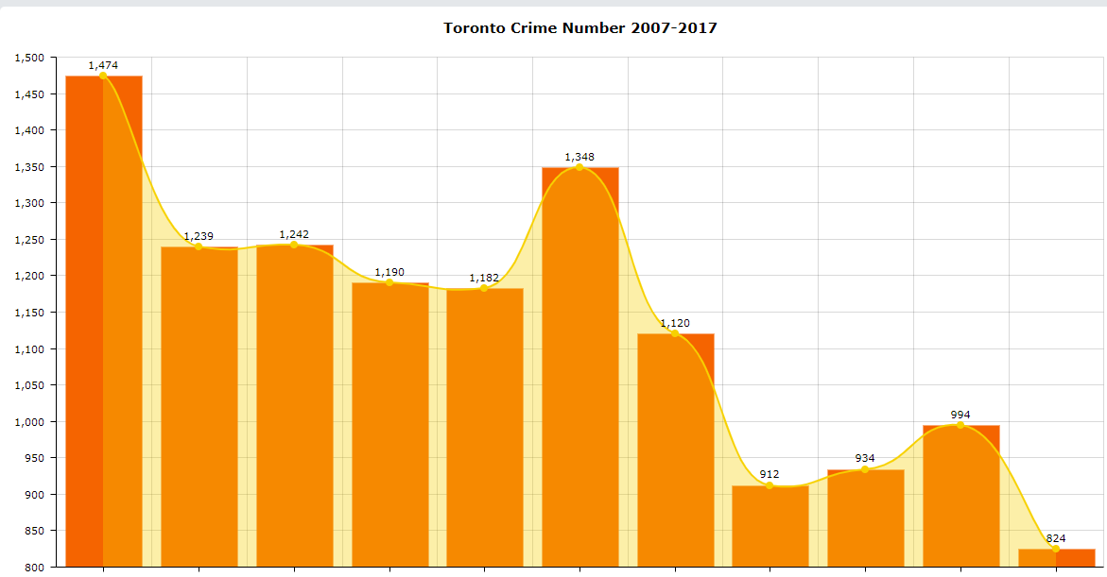
2.KSI Data
二、财务数据汇报
District | District Code | Number | Proportion | Fatal Number | Fatal Ratio
Scarborough | 0 | 2940 | 0.23 | 503 | 0.17
Toronto East York | 1 | 4200 | 0.33 | 451 | 0.11
Etobicoke York | 2 | 3004 | 0.23 | 379 | 0.13
North York | 3 | 2399 | 0.19 | 382 | 0.16
1、资产负债情况
2、项目盈利情况
X-axis is year from 2007-2017, Y-axis is numbers of accidents per year. The chart is showing a decreasing trend of crime frequency in Toronto from 2007-2017, which is an overall positive public security sign.
Among four districts Toronto East York has the largest accidents number, while fatal injuries happens most likely in district Scarborough, with 17% possibilities dead.
3、资金流量情况

Slide 5
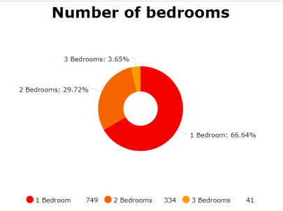
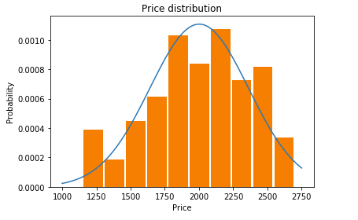
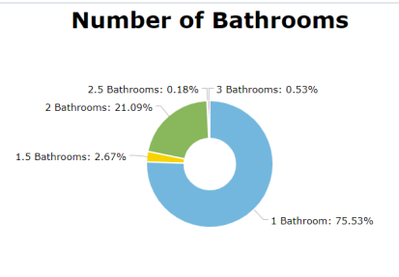
3. House Rental Price Data
二、财务数据汇报
1、资产负债情况
2、项目盈利情况
3、资金流量情况
66.64% of the whole data are 1 bedroom, left with 29.72% 2 bedrooms and only 3.65% 3 bedrooms.1 Bathroom takes the biggest part of the whole, with proportion of 75.53%. To standardize data, data will be filted with 1 Bedroom with 1 bathroom and 0 living room, 712 rows.

Slide 6
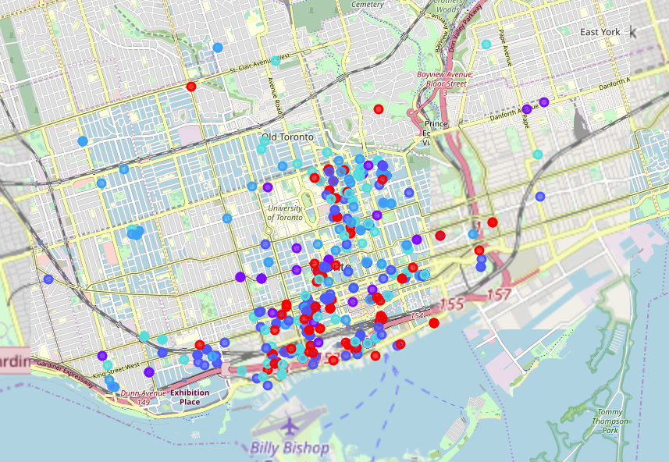
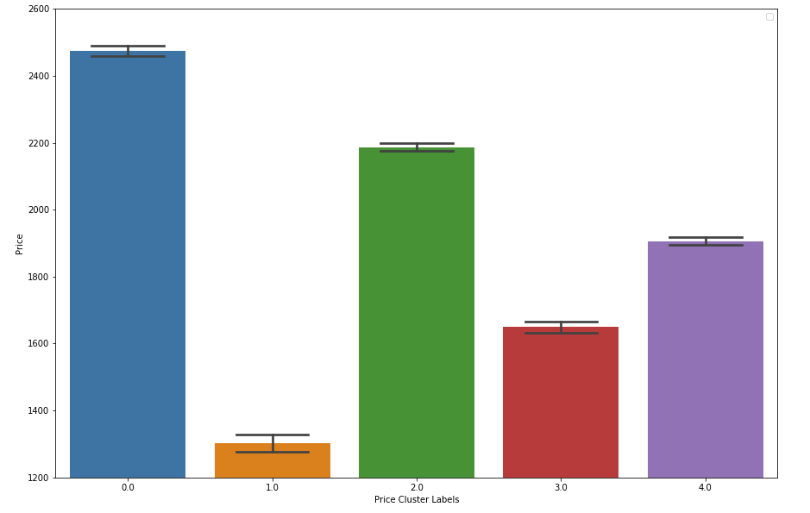
4. Data Clustering
二、财务数据汇报
1、资产负债情况
2、项目盈利情况
3、资金流量情况
The dataset is clustered evetually into 5 clusters, using K-Means algorithm, and cluster representing ranges from 1500-2500. The map show how different clusters are distributed.

Slide 7
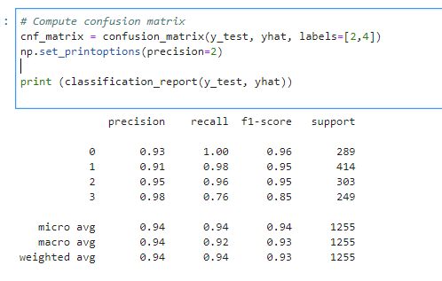
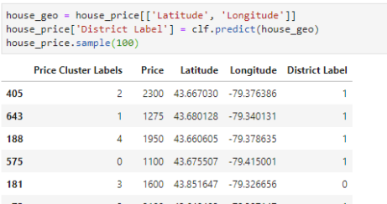
5. Data Classification
二、财务数据汇报
To connect these to tables and explore what's the relationship between price and location, SVM classification algorithm is used to make models based on KSI data, with accuracy of 94%.
1、资产负债情况
2、项目盈利情况
3、资金流量情况
Then use this model to make predictions on house rental price data, to empower futher analysis

Slide 8
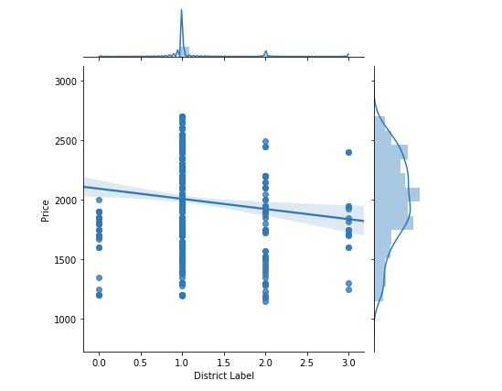
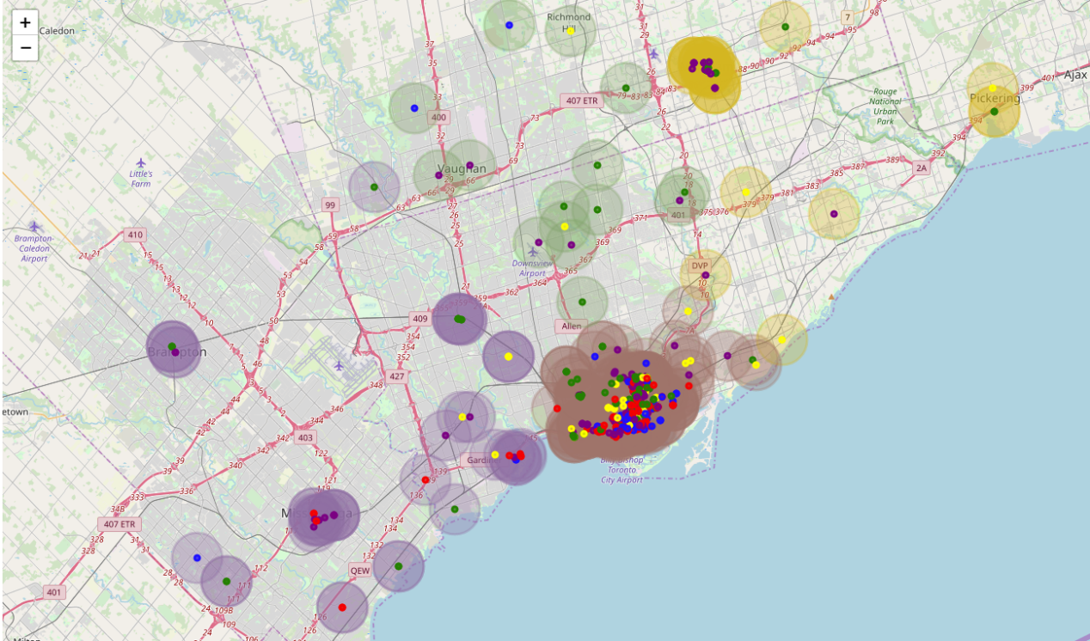
5. Data Analysis
As can see in the map, light color circles are district labels, while color spots are price labels. Though price labels are mixed, we could still find some patterns: blue and yellow labels(expensive ones) are mostly around light brown area, while when away from downtown, green and purple spots(relative cheaper) are spreading all over.
District 0 Scarborough has rental prices around 1300 and 1800-2000, while no more than 2000. Similar to Scarborough, District 3 North York is also around 2000 and below. District 2 Etobicoke York has more house resources, and house price ranges from 1300-2300. District 1 Toronto East York has the largest resources, also contains highest rental price up to 2500 and above.

Slide 9
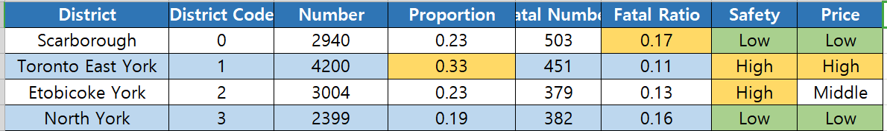
6.Discussion
1.Lower rental price is always with less safety (see Scarborough and North York)
2.Highest price is expected to be a safer area (Toronto East York)
3.Relative safer district doesn’t has to have the highest rental price (Etobicoke York).

Slide 10
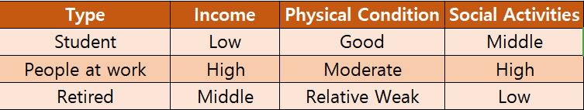
7.Result
Make recommendations to different people:
a. For students: Considering low income and good physical condition, we recommend students considering Scarborough and North York district for their cheap rental price.
b. For people at work: their are having a high demand of social activities, and with abundant income, we recommend Toronto East York district.
c. For retired people: safety comes first for they are becoming weak dealing with all sorts of accidents, and they have lower frequency of social activities, Etobicoke York district is recommended for them.

Slide 11
THANK YOU
• Kaiyu WANG

